Slide 1
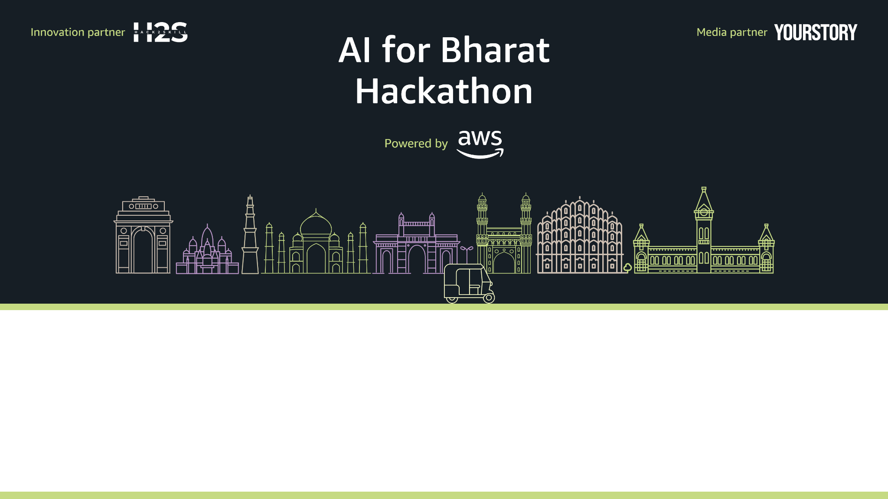
Team Name : Assemblers
Team Leader Name : Sandeep Udeg
Problem Statement : [Professional Track] AI for Rural Innovation & Sustainable Systems

Slide 2

Project Title: Gram-Setu (Unified Rural Engine)
Vision
Gram-Setu is a Unified Rural Ecosystem (URE) platform designed to bridge the digital divide for India’s heartland. Instead of isolated tools, we provide a Multi-Agent "Operating System" that manages the three most critical pillars of rural life: Agricultural Health, Government Welfare Access, & Sustainable Resource Management.
Core Solution
Our solution employs a Supervisor-Worker Architecture to act as a proactive digital companion for rural citizens:
Orchestrator: A central "Supervisor" agent that manages intent and conversation state, ensuring that data flows seamlessly between domains.
Agri-Expert : Provides instant crop disease diagnosis using multimodal vision grounded in the Plant Village dataset and connects users to real-time Mandi prices.
Policy-Navigator : Simplifies complex government schemes (like PM-Kisan and PKVY) using RAG (Retrieval-Augmented Generation) to provide eligibility hallucination-free advice.
Eco-Resource : Processes soil and weather data to provide precise irrigation and energy schedules, significantly reducing resource waste.
Technical Architecture
Intelligence: Powered by Claude 3.5 Sonnet via Amazon Bedrock for high-fidelity reasoning.
Orchestration: Built using the Strands Agents SDK for modular, agentic workflows.
Data Strategy: Uses Amazon S3 for image and sensor log storage, with Bedrock Knowledge Bases for grounding policy advice in verified datasets.
Responsible AI: Integrated with Bedrock Guardrails to ensure all advice is safe, culturally sensitive, and privacy-compliant.
MCP: It allows orchestrator to securely connect to external data source and act as a standardized plug and play interface between Agent and data
Impact & Scalability
Gram-Setu is built to be voice-first and multilingual, making it accessible to users regardless of their literacy level. By optimizing resource use and providing direct market/subsidy linkages, the platform aims to increase net farmer income by 18–22% while reducing water consumption by up to 45%.

Slide 3
Your solution should be able to explain the following
How different is it from any of the other existing ideas?
Unlike existing siloed agri-tech solutions, our platform unifies multiple rural services into a single AI-driven ecosystem that delivers integrated, actionable decisions
Potential for AI-driven unified decision support not just for specific tasks but for overarching strategy
Holistic integration of data across advisory, environmental, market, and operational layers
A shift from standalone tools or service networks to intelligent ecosystem insights
How will it be able to solve the problem?
By integrating fragmented rural data and applying AI-driven decision intelligence, the platform transforms complex agricultural challenges into clear solutions.
Data Integration from Multiple Sources
AI-Driven Analysis & Intelligence
Actionable Recommendations
Actionable Recommendations
Trade-off Based Decision Making
Continuous Learning & Improvement
USP of the proposed solution
A unified AI decision ecosystem that transforms fragmented rural data into actionable, intelligent decisions
One Platform, One AI Brain
Trade-Off Aware Decision Intelligence
Ecosystem-Scale Impact

Slide 4
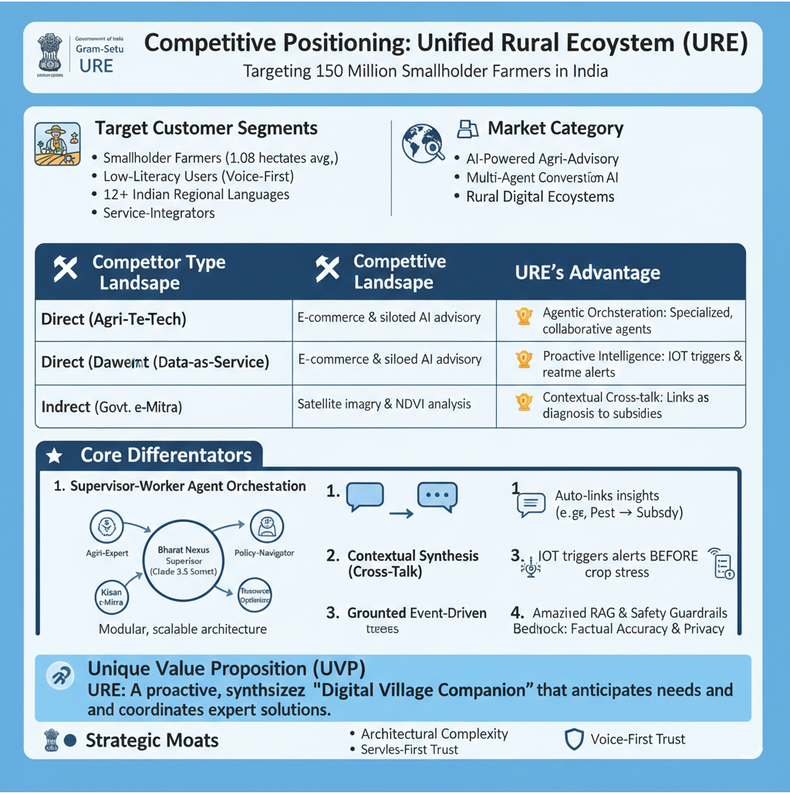
Core Differentiator

Slide 5
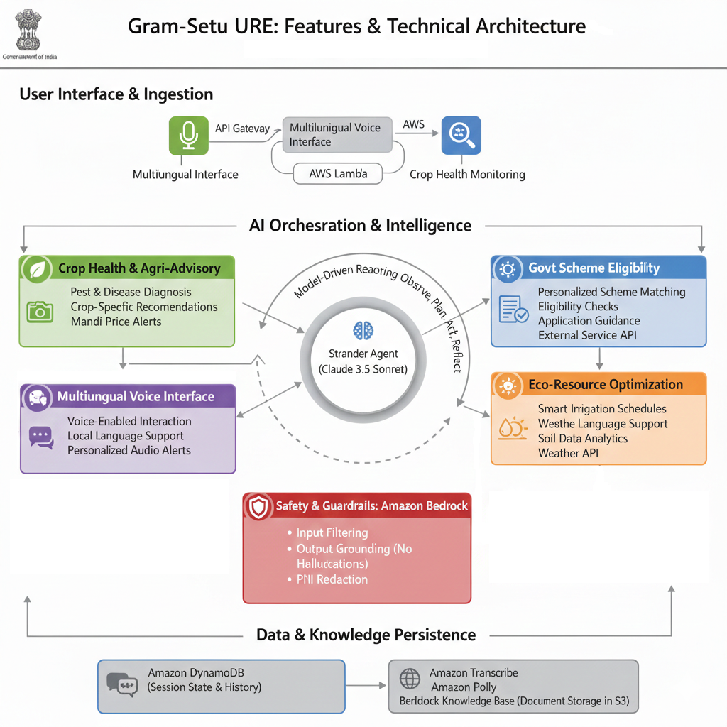
List of features offered by the solution
1
2
3
5
4

Slide 6
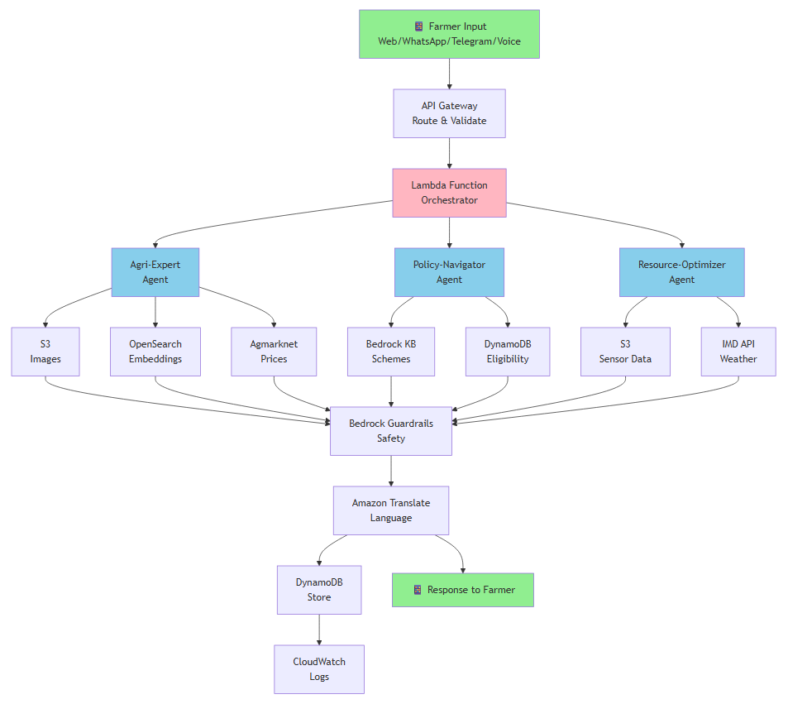
Process flow diagram
🟢 Green = Input/Output
🔵 Blue = Agents
🟠 Orange = Data Sources

Slide 7
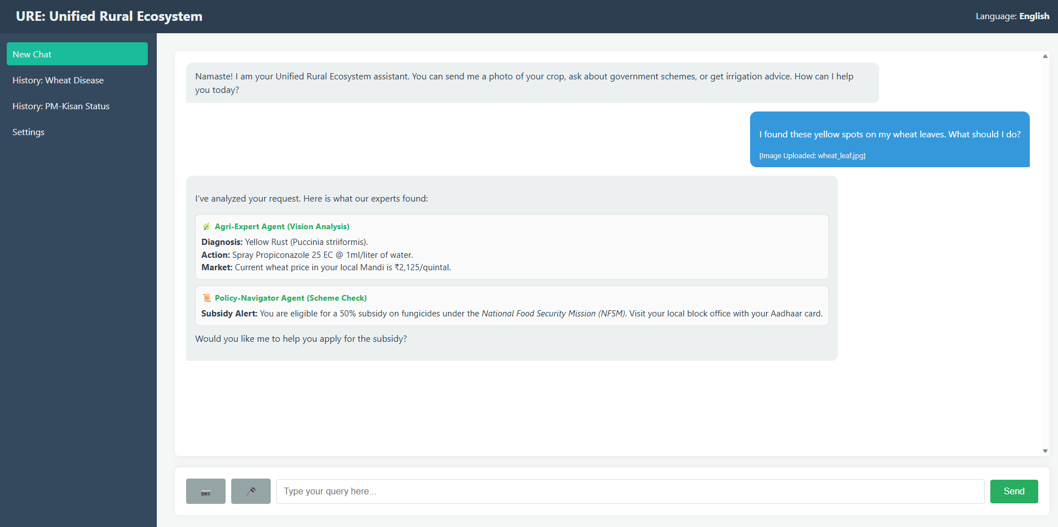
Wireframes diagrams of the proposed solution
Language selection option
Application name
User Provided Input
Agent output providing details of the uploaded images or text, action that needs to be taken for crop and market analysis along with the subsidy information
Navigation to load older communication
Sandeep
Crop image upload
User voice input
User message

Slide 8
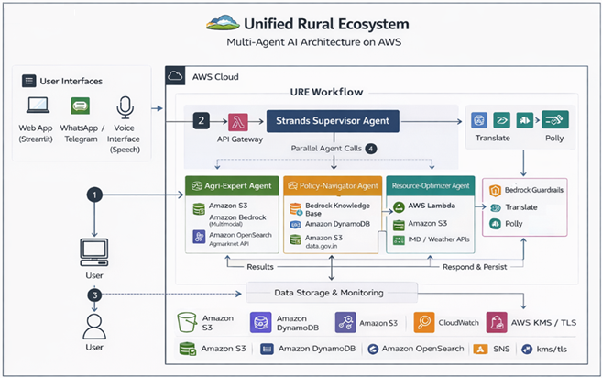
Architecture diagram of the proposed solution

Slide 9
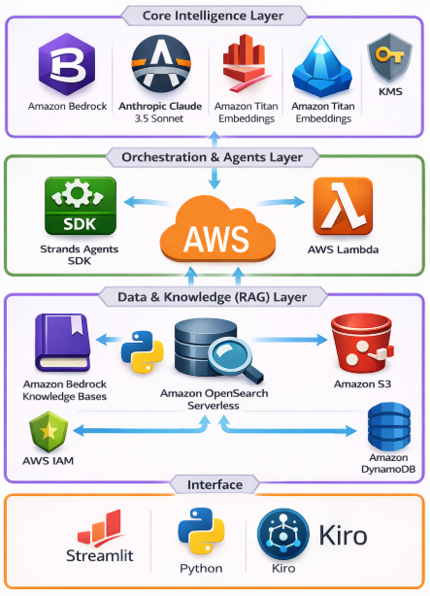
Technologies to be used in the solution
1. Core Intelligence Layer
Amazon Bedrock: Hosts and manages foundation models securely at scale
Anthropic Claude 3.5 Sonnet: Handles advanced reasoning and decision-making
Amazon Titan Embeddings: Generates vector embeddings for semantic search
2. Orchestration & Agents Layer
Strands Agents SDK: An open-source framework used to build the Supervisor-Worker agentic architecture
AWS Lambda: Provides serverless compute to execute logic and connect agents to external APIs
3. Data & Knowledge (RAG) Layer
Amazon Bedrock Knowledge Bases: Manages the RAG pipeline to link agents to private data source
Amazon OpenSearch Serverless: The vector database for low-latency retrieval of government schemes
Amazon S3: Scalable object storage for the Plant Village dataset and user-uploaded images
Amazon DynamoDB: Maintains session state and metadata.
4. Connectivity & Interface
Streamlit: User-facing application interface
Python Runtime: Core execution environment for agent workflows
Kiro Tool: Supports agent monitoring and debugging

Slide 10
Estimated implementation cost (1/2)
Layer | Service | Cost Model | Estimated Cost
Core Intelligence | Amazon Bedrock (Claude 3.5 Sonnet) | Pay-per-inference (tokens) | Moderate - High
Core Intelligence | Amazon Titan Embeddings | Pay-per-embedding | Low
Orchestration & Agents | Strands Agents SDK | Open-source | Free
Orchestration & Agents | AWS Lambda | Pay-per-invocation | Very Low
Data & Knowledge (RAG) | Bedrock Knowledge Bases | Usage-based | Low
Data & Knowledge (RAG) | Amazon Open Search Serverless | Storage + query-based | Moderate
Data & Knowledge (RAG) | Amazon S3 | Pay-per-storage | Very Low
Data & Knowledge (RAG) | Amazon DynamoDB | On-demand reads/writes | Low
Interface | Streamlit | Open-source | Free
Interface | Python Runtime | Open-source | Free
Interface | Kiro Tool | Tooling / Dev support | Minimal
Model Context Protocol | MCP | Open-source | Free
Notes :
1. Total cost is directly proportional to the number of users. 2. Depending on LLM selected cost can be further optimized

Slide 11
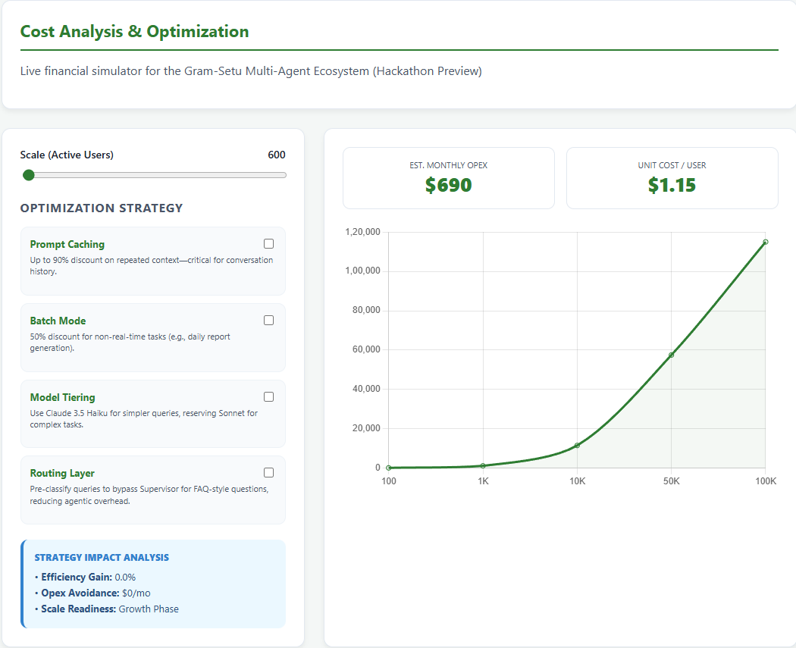
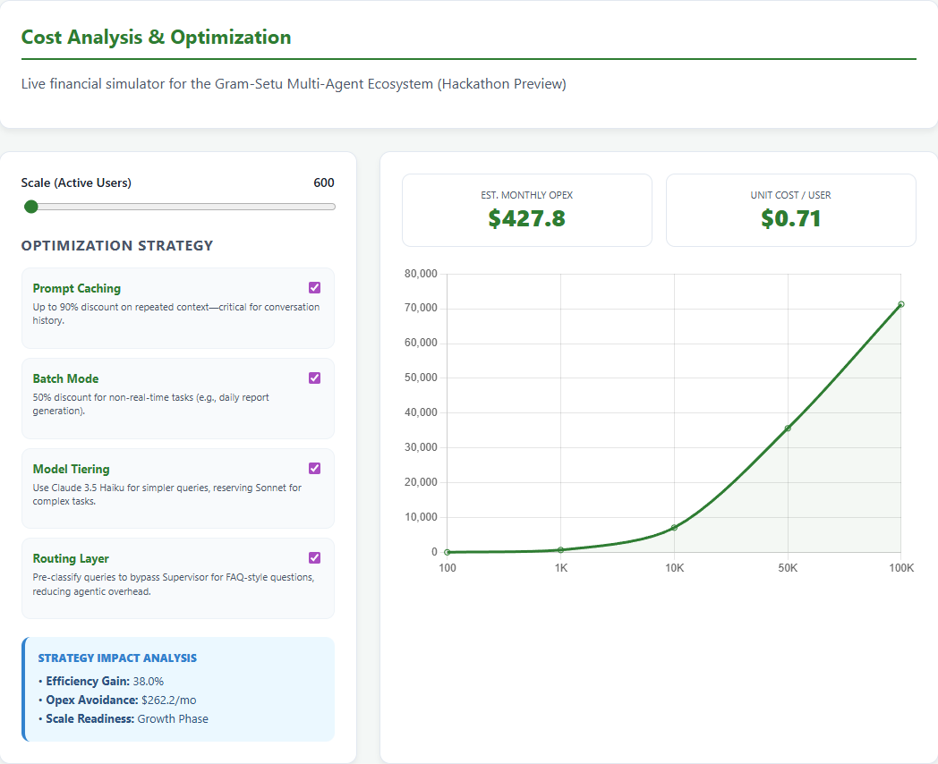
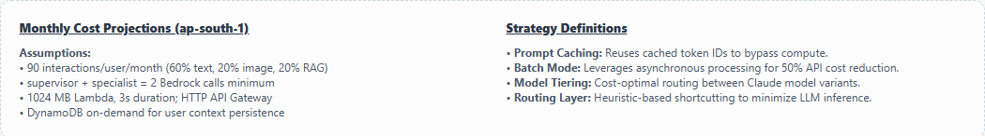

Estimated implementation cost (2/2)
Please click here to view the Cost Analysis
Scan QR Code to view on Mobile
**it’s only for simulation purposes actual cost may differ on case to case basis

Slide 12
